Slide 1
Cisco Networking Academy
Innovate like a Technologist. Think like an Entrepreneur. Act as a Social Agent.
Name
Title
Date

Slide 2
Network Programmability with Cisco APIC-EM
Chapter 1: Introduction to Basic Programming with Python
Presenter Name
Presenter Info (Title, School, etc.)
Date

Slide 3
Introduction

Slide 4
Welcome

Slide 5

Introduction to Python and Programming Basics
This chapter of the course covers the following objectives:
Describe how Communities of Practice provide value to programmers.
Use Python to create programs that accept user input and read and write to external files.
Create a Python application that accesses an API based on user input and processes and displays the JSON data that is returned.

Slide 6
Verify Your PC is Ready
You should have already completed the Lab - PC Setup for Workshop.
Your PC should include the following:
Python installed and verified
Postman installed
JSONView installed
Verify that your PC is ready to complete the tasks of the workshop.

Slide 7
Workshop Begins
Introduce instructors/assistants/other key people
For large groups, just use name tags
For smaller groups: Name, level of programming comfort (1 - novice to 5 - expert in a language)
Logistics/Expectations: Bathroom, refreshments, breaks, lunch, pace of workshop, what to do if you get behind
Add slides to this section to address your workshop’s specific needs.

Slide 8
Code and Communities of Practice

Slide 9
Code

Slide 10
Power of Code
Everybody... should learn how to program a computer... because it teaches you how to think.
Steve Jobs
Founder, Apple
Coding is a huge base...to build off of...to go in the direction [you] want to.
Chris Bosh
NBA All-Star
[Coding] is the closest thing we have to a superpower.
Drew Houston
Dropbox Creator
Great coders are today’s rock stars.
will.i.am
Black Eye Peas Creator

Slide 11
The Power of Code
© 2016 Cisco and/or its affiliates. All rights reserved. Cisco Confidential
11

Slide 12
Communities of Practice

Slide 13

Communities of Practice (CoPs)
Communities of practice are groups of people who share a concern or a passion for something they do and learn how to do it better as they interact regularly.
Jean Lave & Etienne Wenger

Slide 14
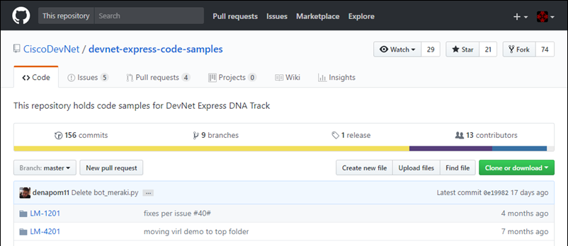
CoPs for Programmers - GitHub
GitHub is the open source software version control system started by Linus Torvalds, the creator of Linux.
https://github.com/

Slide 15
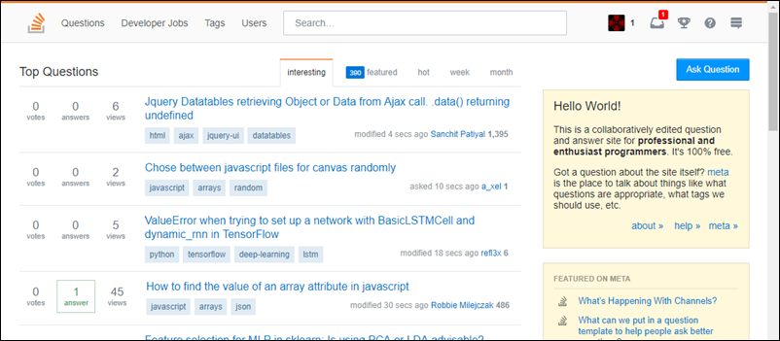
CoPs for Programmers - Stack Overflow
Stack Overflow maintains a library of detailed answers to every question about programming.
https://stackoverflow.com/

Slide 16

CoPs for Programmers - Cisco DevNet
Cisco DevNet offers support to developers and programmers who want to build Cisco-enable applications or use Cisco APIs to enhance and manage their networks
https://developer.cisco.com

Slide 17
Python Basics

Slide 18
Python Interpreter

Slide 19
Start Python
Windows
C:\> python
Python 3.6.3 (v3.6.3:2c5fed8, Oct 3 2017, 17:26:49) [MSC v.1900 32 bit (Intel)] on win32
Type "help", "copyright", "credits" or "license" for more information.
>>>
Mac or Linux
$ python3
Python 3.5.2 (default, Aug 18 2017, 17:48:00)
[GCC 5.4.0 20160609] on linux
Type "help", "copyright", "credits" or "license" for more information.
>>>
Notes:
To start Python on Windows computer, open a command line window and type python
To start Python on Mac or Linux, open a command line window and type python3

Slide 20
Use Interactive Interpreter as a Calculator
$ python3
Python 3.5.2 (default, Aug 18 2017, 17:48:00)
[GCC 5.4.0 20160609] on linux
Type "help", "copyright", "credits" or "license" for more information.
>>> 2+3
5
>>> 10-4
6
>>> 2*4
8
>>> 20/5
4
>>> 3**2
9
Notes:
The three angle brackets (>>>) indicate that you are in Python's interactive interpreter. From here, you can do a variety of basic programming tasks including math operations. Python uses the standard order of operations commonly known as PEMDAS. Mathematical expressions are evaluated in the following order.
Parentheses Exponents Multiplication and Division Addition and Subtraction
Try entering an expression with a complex order of operations in the interactive interpreter.

Slide 21
Use Interpreter to print Hello World
>>> "Hello World!"
'Hello World!'
>>> 'Hello World!'
'Hello World!'
>>> print("Hello World!")
Hello World!
Strings can be enclosed with single quotes or double quotes.
To remove the single quotes in the output, use the print command.
Notes:
A string is any sequence of characters such as letters, numbers, symbols, or punctuation marks. The interactive interpreter will directly output text that you enter as a string as long as you enclose the string in either single quotes (') or double quotes (").
The print command can be used in a script to output a string

Slide 22
Quit the Interpreter and Start IDLE
Python includes the Integrated Development Environment (IDLE)
Windows - open IDLE from the Start menu
Mac or Linux - open IDLE from the command line.
Windows
Start > Python 3.6 > IDLE (Python 3.6 32-bit).
Mac or Linux
>>> "Hello World!"
'Hello World!'
>>> 'Hello World!'
'Hello World!’
>>> quit()
$ idle3
Notes:
There are many development environments available for programmers to manage their coding projects. However, in this workshop you will use Python's Integrated Development Environment (IDLE).
To access IDLE on a Windows computer, click Start > Python 3.6 > IDLE (Python 3.6 32-bit).
To access IDLE on Mac and Linux computers, enter quit() in the interactive interpreter to exit and then type idle3 at the command line to launch,

Slide 23
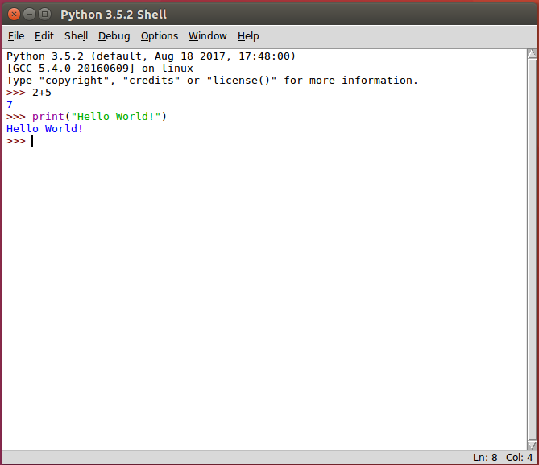
IDLE Benefits
Provides color coding
Includes a text editor for writing programs
Quickly save and run programs

Slide 24
Activity - Write, Save, and Run Your First Program
In IDLE, click File > New File (Ctrl+N) to open an Untitled script file.
Save the file as 01_hello-world.py in your GitHub project directory.
Enter the following in the script:
print("Hello World!")
Save the script; click File > Save (Ctrl+S)
Run the script; click Run > Run Module (F5)

Slide 25
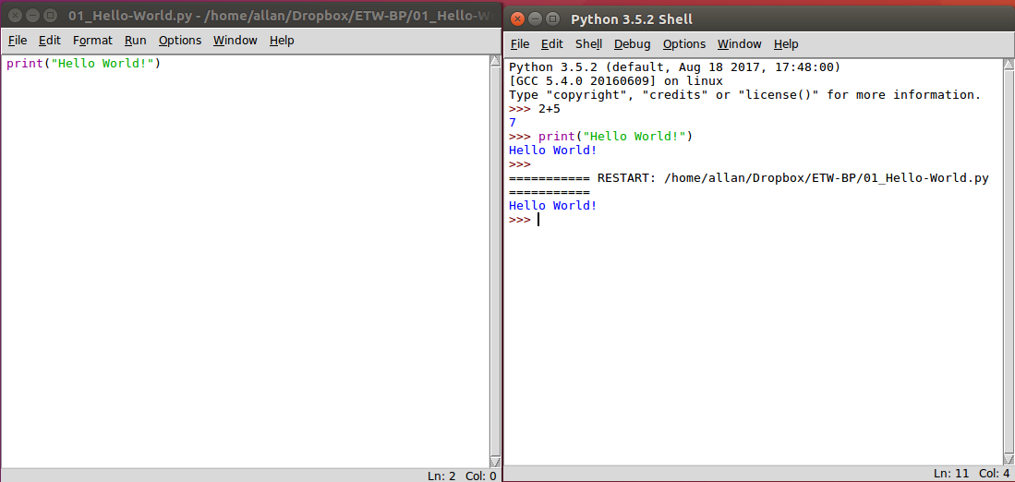
First Program and Output
Program File
Output
Notes:
DLE has two main windows:
IDLE Shell
IDLE Editor
The IDLE Shell provides an interactive interpreter with colorizing of code input, output, and error messages. It also includes a tool popup that provides syntactical help for the command you are currently using
The IDLE Editor provides a text editor with code colorization and syntactical help for writing python scripts.

Slide 26
Data Types, Variables, and Conversions

Slide 27
Basic Data Types
The four basic data types we will use are:
Integer
Float
String
Boolean
Use the type() command to determine the data type.
>>> type(98)
<class 'int'>
>>> type(98.6)
<class 'float'>
>>> type("Hi!")
<class 'str'>
>>> type(True)
<class 'bool'>
Notes:
In programming, data types are a classification which tells the interpreter how the programmer intends to use the data. For example, the interpreter needs to know if the data the programmer entered is a number or a string. Although there are several different data types, we will focus only on the following:
Integer - used to specify whole numbers (no decimals), such as 1, 2, 3, and so on. If an integer is entered with a decimal, the interpreter ignores the decimal. For example, 3.75 is interpreted as 3.
Float - used to specify numbers that need a decimal value, such as 3.14159.
String - any sequence of characters such as letters, numbers, symbols, or punctuation marks.
Boolean - any data type that has a value of either True or False.
Use the type() function to determine the data type

Slide 28
Boolean Comparison Operators
Operator | Meaning
> | Greater than
< | Less than
== | Equal to
!= | Not equal to
>= | Greater than or equal to
<= | Less than or equal to
>>> 1<2
True
>>> 1>2
False
>>> 1==1
True
>>> 1!=1
False
>>> 1>=1
True
>>> 1<=1
True
Notes:
The Boolean data type makes use of the operators shown in the table.
In the IDLE shell, try out the different Boolean operators

Slide 29
Creating and Using a Variable
Use a single equal sign to assign a value to a variable.
A variable can then be called for other operations.
>>> x=3
>>> x*5
15
>>> "Cisco"*x
'CiscoCiscoCisco'
Notes:
The Boolean operator for determining whether two values are equal is the double equal sign (==). A single equal sign (=) is used to assign a value to a variable. The variable can then be used in other commands to recall value

Slide 30
Concatenate Multiple String Variables
Concatenation is the process of combining multiple strings.
>>> str1="Cisco"
>>> str2="Networking"
>>> str3="Academy"
>>> space=" "
>>> print(str1+space+str2+space+str3)
Cisco Networking Academy
>>>
Notes:
Concatenation is the process of combining multiple strings into one string. For example, the concatenation of "foot" and "ball" is "football". In the example, four variables are concatenated together in a print() statement with the plus sign (+). Notice that the space variable was defined for use as white space between the words.

Slide 31
Converting Data Types
Concatenation does not work for different data types.
>>> x=3
>>> print("This value of X is " + x)
Traceback (most recent call last):
File "<pyshell#27>", line 1, in <module>
print("This value of X is " + x)
TypeError: Can't convert 'int' object to str implicitly

Slide 32
Converting Data Types
Use the str() command to convert the data type to a string.
>>> x=3
>>> print("The value of x is " + x)
Traceback (most recent call last):
File "<pyshell#27>", line 1, in <module>
print("This value of X is " + x)
TypeError: Can't convert 'int' object to str implicitly
>>> print("The value of x is " + str(x))
The value of x is 3
>>>

Slide 33
Converting Data Types
The type for the variable x is still an integer.
>>> x=3
>>> print("The value of x is " + x)
Traceback (most recent call last):
File "<pyshell#27>", line 1, in <module>
print("This value of X is " + x)
TypeError: Can't convert 'int' object to str implicitly
>>> print("The value of x is " + str(x))
The value of x is 3
>>> type(x)
<class 'int’>
Notes:
Notice that the data type for the variable x is still an integer. To convert the data type, reassign the variable to the new data type

Slide 34
Converting Data Types
To convert the data type, reassign the variable to the new data type.
>>> x=3
>>> print("The value of x is " + x)
Traceback (most recent call last):
File "<pyshell#27>", line 1, in <module>
print("This value of X is " + x)
TypeError: Can't convert 'int' object to str implicitly
>>> print("The value of x is " + str(x))
The value of x is 3
>>> type(x)
<class 'int'>
>>> x=str(x)
>>> type(x)
<class ‘str'>

Slide 35
Converting Data Types
Use “{:.2f}”.format to display a float to two decimal places.
Change the 2 to increase or decrease decimal places.
>>> pi = 22/7
>>> print(pi)
3.142857142857143
>>> print("{:.2f}".format(pi))
3.14
>>>

Slide 36
Lists and Dictionaries

Slide 37
Lists
>>> hostnames=["R1","R2","R3","S1","S2"]
>>> type(hostnames)
<class 'list'>
>>> len(hostnames)
5
>>> hostnames
['R1', 'R2', 'R3', 'S1', 'S2']
A list is an ordered list of items.
Create a list using the brackets [ ] and enclosing each item in the list with quotes.
Use the type() command to verify the data type.
Use the len() command return the number of items in a list.
Call the list variable name to display it’s contents.
Notes:
In programming, a list variable is used to store multiple pieces of ordered information

Slide 38
Lists
>>> hostnames=["R1","R2","R3","S1","S2"]
>>> type(hostnames)
<class 'list'>
>>> len(hostnames)
5
>>> hostnames
['R1', 'R2', 'R3', 'S1', 'S2']
>>> hostnames[0]
'R1'
>>> hostnames[-1]
'S2'
>>> hostnames[0]="RTR1"
>>> hostnames
['RTR1', 'R2', 'R3', 'S1', 'S2']
>>> del hostnames[3]
>>> hostnames
['RTR1', 'R2', 'R3', 'S2']
>>>
Use the index to refer to an item and manipulate the list
The first item in a list is indexed as zero, the second is indexed as one, and so on.
The last item can be referenced with index [-1]
Replace an item by assigning a new value to the index.
Use the del() command to remove an item from a list.
Notes:
Also called an array in some programming environments, an item in a list can be referenced and manipulated using its index

Slide 39
Dictionaries
>>> ipAddress = {"R1":"10.1.1.1","R2":"10.2.2.1","R3":"10.3.3.1"}
>>> type(ipAddress)
<class 'dict'>
A list of unordered key/value pairs
Create a dictionary using the braces { }
Each dictionary entry includes a key and a value.
Separate key and values with a colon.
Use quotes for keys and values that are strings.
Notes:
Dictionaries are unordered lists of objects. Each object contains a key/value pair. In the example, a dictionary ipAddress is created with three key/value pairs to specify the IP address values for three key routers.

Slide 40
Dictionaries
>>> ipAddress = {"R1":"10.1.1.1","R2":"10.2.2.1","R3":"10.3.3.1"}
>>> type(ipAddress)
<class 'dict'>
>>> ipAddress
{'R1': '10.1.1.1', 'R2': '10.2.2.1', 'R3': '10.3.3.1'}
>>> ipAddress['R1']
'10.1.1.1’
>>> ipAddress["S1"]="10.1.1.10"
>>> ipAddress
{'R1': '10.1.1.1', 'R2': '10.2.2.1', 'R3': '10.3.3.1', 'S1': '10.1.1.10'}
>>> "R3" in ipAddress
True
>>>
Use the key to refer to an entry
The key is enclosed with brackets [ ].
Keys that are strings can be referenced using single or double quotes.
Add a key/value pair by setting the new key equal to a value.
Use key in dictionary command to verify if a key exist in the dictionary
Notes:
Unlike lists, objectives inside a dictionary cannot be referenced by their sequence number. Instead, you reference a dictionary object using its key

Slide 41
Activity - Troubleshoot List and Dictionary Code
Open 02_list-dicts.py.
Run the code.
Troubleshoot the code until the script runs without errors.
What errors did you fix in the script?
Notes:
Open the script 02_list-dicts.py. This script creates a list of the BRICS countries (Brazil, Russia, India, China, and South Africa). It then creates a dictionary for each country's capital(s). A list is used for South Africa's three capitals. The script is then supposed to print the country list, capital dictionary, and the 2nd listed capital for the value of South Africa. However, there are errors in the script. Find and fix the errors.

Slide 42
User Input

Slide 43
The Input Function
The input() function provides a way to get information from the user.
>>> firstName = input("What is your first name? ")
What is your first name? Bob
>>> print("Hello " + firstName +"!")
Hello Bob!
>>>
Notes:
Most programs require some type of input either from a database, another computer, mouse clicks, or keyboard input. For keyboard input, use the function input() which includes an optional parameter to provide a prompt string.
If the input function is called, the program will stop until the user provides input and hits the Enter key

Slide 44
Activity - Create a Script to Collect Personal Information
Open a blank script file and save it in your GitHub project directory as 03_personal-info.py.
Create a script that asks for four pieces of information such as: first name, last name, location, and age.
Create a variable for a space: space = " "
Add a print statement that that combines all the information in one sentence.
Run the script and troubleshoot any errors.

Slide 45
If Functions and Loops

Slide 46
If/Else Function
Open a blank script and save it as 04_if-vlan.py.
Create a simple if function that compares two values and prints the results.
Run the script and troubleshoot any errors.
Change the values to test the else print statement.
nativeVLAN = 1
dataVLAN = 100
if nativeVLAN == dataVLAN:
print("The native VLAN and the data VLAN are the same.")
else:
print("This native VLAN and the data VLAN are different.")
Notes:
In programming, conditional statements check if something is true and then carry out instructions based on the evaluation. If the evaluation is false, different instructions are carried out.
Modify the variables so that nativeVLAN and dataVLAN have the same value. Save and run the script again.

Slide 47
If/Elif/Else Function
Open a blank script and save it as 05_if-acl.py.
Create a more complex if function that takes user input and includes an elif loop.
Note that the input needs to be converted to an integer.
aclNum = int(input("What is the IPv4 ACL number? "))
if aclNum >= 1 and aclNum <= 99:
print("This is a standard IPv4 ACL.")
elif aclNum >=100 and aclNum <= 199:
print("This is a extended IPv4 ACL.")
else:
print("This is not a standard or extended IPv4 ACL.")
Notes:
What if we have more than two conditional statements to consider? In this case, we can use elif statements in the middle of the if/else function. An elif statement is evaluated if the if statement is false and before the else statement. You can have as many elif statements as you would like. However, the first one matched will be executed and none of the remaining elif statements will be checked. Nor will the else statement.
The script in the example asks the user to input the number of an IPv4 ACL and then checks whether that number is a standard IPv4 ACL, extended IPv4 ACL, or neither standard or extended IPv4 ACL.

Slide 48
For Loop
A for loop iterates through items in a list, dictionary, or other sequenced data type.
The variable name “item” is arbitrary and can be anything the programmer chooses.
>>> devices=["R1","R2","R3","S1","S2"]
>>> for item in devices:
print(item)
R1
R2
R3
S1
S2
>>>
Notes:
The Python for command is used to loop or iterate through the elements in a list or perform an operation on a series of values. The example demonstrates how a for loop can be used to print the elements in a list. The variable name item is arbitrary and can be anything the programmer chooses.

Slide 49
For Loop with Embedded If
Using an If loop inside the For loop
>>> for item in devices:
if "R" in item:
print(item)
R1
R2
R3
>>>
Notes:
What if you only want to list the items that begin with the letter R? An if statement can be embedded in a for loop to achieve this

Slide 50
Use a For Loop to Create a New List
Create an empty list called switches.
Iterate through the devices list to create the switch list.
>>> switches=[]
>>> for item in devices:
if "S" in item:
switches.append(item)
>>> switches
['S1', 'S2']
>>>
Notes:
You can also use a combination of the for loop and if statement to create a new list. Example 3 shows how to use the append() method to create a new list called switches.

Slide 51
Create a While Loop
Open a blank script and save it as 06_while-loop.py.
Create a program with a while loop that counts to a user’s supplied number.
Convert the string to an integer: x = int(x)
Set a variable to start the count: y = 1
While y <= x, print the value of y and increment y by 1.
x=input("Enter a number to count to: ")
x=int(x)
y=1
while y<=x:
print(y)
y=y+1
Notes:
Instead of running a block of code once, as in an if statement, you can use a while loop. A while loop keeps executing a code block as long as a boolean expression remains true. This can cause a program to run endlessly if you do not make sure your script includes a condition for the while loop to stop. While loops will not stop until the boolean expression evaluates as false.
In the example script, the while loop counts from 1 to a number entered by the user.

Slide 52
Modify the While Loop to Use Break
Modify the while loop to use a Boolean check and break to stop the loop.
Replace while y<=x with while True
Add an if function to break the loop when y>x.
x=input("Enter a number to count to: ")
x=int(x)
y=1
while True:
print(y)
y=y+1
if y>x:
break
Notes:
Instead of using while y <= x, we can modify the while loop to use a Boolean check and break to stop the loop when the check evaluates as false

Slide 53
Use a While Loop to Check for User Quit
Add another while loop to the beginning of the script which will check for a quit command.
Add an if function to the while loop to check for ‘q’ or ‘quit’ .
while True:
x=input("Enter a number to count to: ")
if x == 'q' or x == 'quit':
break
x=int(x)
y=1
while True:
print(y)
y=y+1
if y>x:
break
Notes:
What if we want the program to run as many times as the user wants until the user quits the program? To do this, we can embed the program in a while loop that checks if the user enters a quit command, such as q or quit.

Slide 54
File Access

Slide 55
Read an External File and Print the Contents
Open a blank script and save it as 07_file-access.py.
Create a script to read and print the content of a file.
The ‘devices.txt’ file should be in the same directory as your script.
file=open("devices.txt","r")
for item in file:
print(item)
file.close()
Notes:
In addition to user input, you can access a database, another computer program, or a file to provide input to your program. The open() function can be used to access a file. The name of the file, devices.txt, is specified, and then a mode for opening the file. The r mode means read the file. We will also use the a mode, which appends data to the end of the file.

Slide 56
Remove Blank Lines from the Output
Use strip attribute to remove the blank lines.
file=open("devices.txt","r")
for item in file:
item=item.strip()
print(item)
file.close()
Notes:
Use the strip() method to remove blank lines from your output.

Slide 57
Copy File Content Into a List Variable
Create an empty list.
Use the append attribute to copy file content to the new list.
devices=[]
file=open("devices.txt","r")
for item in file:
item=item.strip()
devices.append(item)
file.close()
print(devices)
Notes:
Most of the time when programmers access an external resource such as a database or file, they are wanting to copy that content into a local variable that can then be referenced and manipulated without impacting the original resource. Here, we create a list called devices[] and store the contents of the devices.txt file in the new list.

Slide 58
Activity – Modify the Script to Add an Item to the File
Open a new file and save it as 07_file-access_actvity.py.
For the open() function use the mode a, which will allow you to append a item to the devices.txt file.
Inside a while True: loop, embed an input() function command that asks the user for the new device.
Set the value of the user's input to a variable named newItem.
Use an if statement that breaks the loop if the user types exit and prints the statement "All done!"
Use the command file.write(newItem + “\n”) to add the new user provided device.
Notes:
What if you want to add more devices to the devices.txt file? You can open the file in append mode and then ask the user to provide the name of the new devices. Complete these steps to create a script.

Slide 59
APIs and Parsing JSON

Slide 60
APIs and RESTful APIs

Slide 61

Application Programming Interface (API)
An API allows one piece of software talk to another.
An API is analogous to a power outlet.
Without a power outlet, what would you have to do to power your laptop?
Open the wall
Unsheath wires
Splice wires together
Understand all the wires in the wall
An API defines how a programmer can write a piece of software to extend an existing application’s features or even build entirely new applications.

Slide 62

API Example
Restaurant Recommendation App
Returns a list of relevant restaurants in the area
Integrates a third-party API to provide map functionality
The map API enforces a specification of an interface

Slide 63


Web Services Interface using HTTP
Web browsers use Hypertext Transfer Protocol (HTTP) to request (GET) a web page.
If successfully requested (HTTP status code 200), web servers respond to GET requests with a Hypertext Markup Language (HTML) coded web page.
Request
GET /index.htm HTTP/1.1
Send me the Cisco.com home page
Here’s the home page.
Client
Response
HTTP 200 OK <html>
Web Server

Slide 64
RESTful API using HTTP
Representation State Transfer (REST) APIs use HTTP to interface with RESTful services.
The HTTP request asks for JavaScript Object Notation (JSON) formatted data.
If successfully formatted according to the API documentation, the server will respond with JSON data.
Request
GET /json?address=san jose
Send me San Jose address info
Here’s the address info in JSON.
Client
Response
HTTP 200 OK {json data}
API Endpoint

Slide 65
RESTful API using HTTP
Representation State Transfer (REST) APIs use HTTP to interface with RESTful services.
The HTTP request asks for JavaScript Object Notation (JSON) formatted data.
If successfully formatted according to the API documentation, the server will respond with JSON data.
Request
GET /json?address=san jose
Send me San Jose address info
Here’s the address info in JSON.
Client
Response
HTTP 200 OK {json data}
API Endpoint

Slide 66
Anatomy of a RESTful Request
https://www.mapquestapi.com/directions/v2/route?outFormat=json&key=KEY&...
API Server
Resources
Format
Parameters
API Server: The URL for the server that answers REST requests
Resources: Specifies the API that is being requested.
Format: Usually JSON or XML
Parameters: Specifies what data is being requested

Slide 67
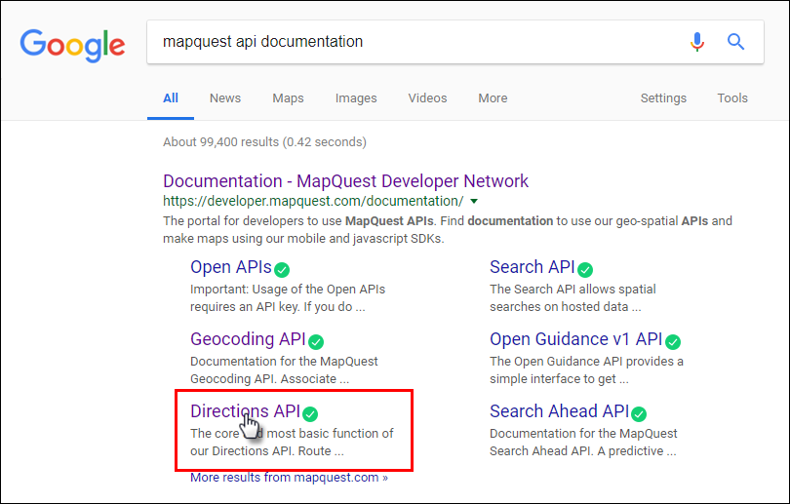
API Documentation
Use an Internet search to find documentation for an API.
Notes:
To successfully construct an API request, you must follow the API documentation. You can quickly find API documentation using an Internet search.

Slide 68
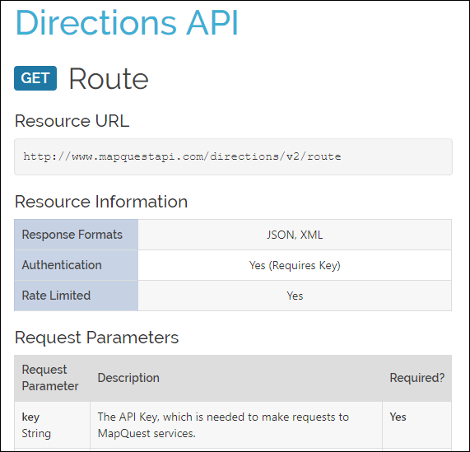
API Documentation
The API documentation will specify...
The request format (JSON, XML, or text)
The request parameters
The response fields

Slide 69
JSON and XML

Slide 70
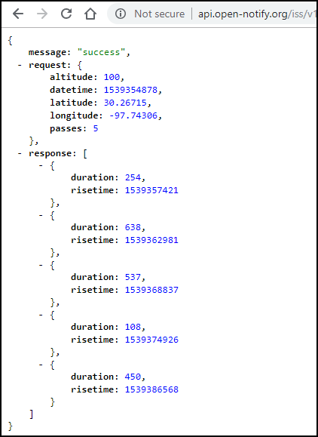
JSON Response Data
http://api.open-notify.org/iss/v1/?lat=30.26715&lon=-97.74306
Enter the above URL in your browser to get a JSON response.
JSON data looks a lot like a Python dictionary.
The third item in the dictionary is the response element.
Inside the list are five dictionaries.
Notes:
JavaScript Object Notation (JSON) is a format for storing and exchanging text between a server and a client application. It is easy to read and write. JSON is a very popular format that web services and APIs use to provide public data because it is easy to parse and can be used with most modern programming languages including Python.
In JSON, objects are indicated by curly braces and resemble Python dictionaries. JSON arrays are held in square brackets and resemble Python lists. To simplify the discussion, we will refer to the JSON structures using the familiar Python terms. Keep in mind however, that JSON data is usually converted to Python data structures before it is used by Python programs.

Slide 71
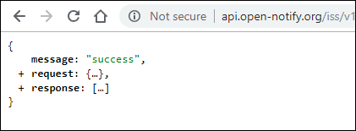
JSON Response Data
http://api.open-notify.org/iss/v1/?lat=30.26715&lon=-97.74306
Collapse components of the JSON to better view its structure.
In the example, JSON returns three root elements: message, request, and response
The message root returns the HTTP status code.
The request root shows default parameters and the parameters entered in the request.
The response root typically returns an array with relevant responses.

Slide 72
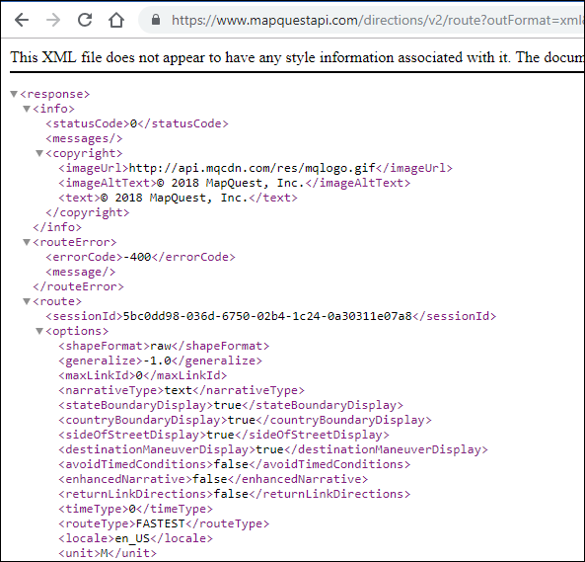
XML Response Data
https://www.mapquestapi.com/directions/v2/route?outFormat=xml&key=KEY...
Extensible Markup Language (XML) extends the functionality of HTML allowing web programmers to construct custom tags.
To get XML data instead of JSON from the MapQuest API, add the outFormat=xml to the URL structure.
You can see in the XML response that the embedded dictionaries have the same basic structure as JSON.

Slide 73
Parsing JSON with Python

Slide 74
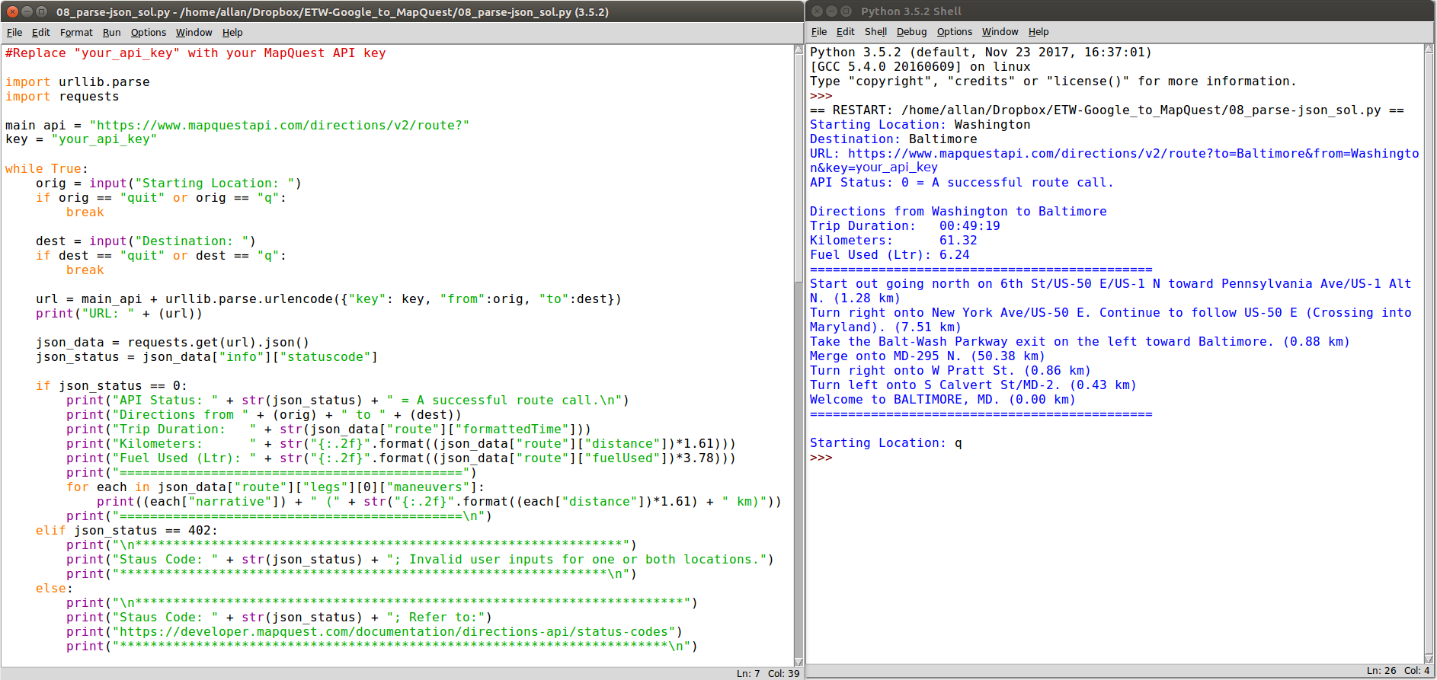
Demonstration - MapQuest API Application
Notes:
In this section, you will create an application that retrieves JSON data from the MapQuest Directions API, parses the data, and formats it for output to the user. The example shows output from a functioning version of the program. Notice that the user entered different values for a trip from Washington to Baltimore and then quit the program.

Slide 75
MapQuest API Application Objectives
To build this application, you will complete the following objectives:
Obtain a MapQuest API Key.
Import necessary modules.
Create API request variables and construct a URL.
Add user input functionality.
Add a quit feature so that the user can end the application.
Display trip information for time, distance, and fuel usage.
Iterate through the JSON data to extract and output the directions.
Display error messages for invalid user input.

Slide 76
Authenticating a RESTful Request
https://www.mapquestapi.com/directions/v2/route?key=your_api_key&to=Baltimore&...
API Server
Resources
Token
Parameters
None: The API resource is public and anybody can place the request.
Basic HTTP: The username and password are passed to the server in an encoded string.
Token: A secret key generally retrieved from the Web API developer portal.
Open Authorization (OAuth): An open standard for retrieving an access token from an Identity Provider. The token is then passed with each API call.
Notes:
Before building the application, you will need to obtain a key from MapQuest developer site, which you will do in the next step. Previously, you used no authentication to access the ISS Pass Predictions API. However, many APIs require some form of authentication.

Slide 77
Activity - Get Your MapQuest API Key
Go to: https://developer.mapquest.com/.
Click Sign Up at the top of the page.
Fill out the form to create a new account. For Company, enter Cisco Networking Academy Student.
After clicking Sign Me Up, you are redirected to the Manage Keys page.
Click Approve All Keys and expand My Application.
Copy your Consumer Key to Notepad for future use.
Notes:
Note: MapQuest may change the process for obtaining a key. If the steps above are no longer valid, search for “steps to generate mapquest api key”.

Slide 78
Importing Modules
Open a blank script file and save it as 08_parse-json1.py.
Import modules
import urllib.parse import requests
Notes:
To begin our script for parsing JSON data, you will need to import two modules from the Python library: requests and urllib.parse. The request module provides functions for retrieving JSON data from a URL. The urllib.parse module provides a variety of functions that will enable us to parse and manipulate the JSON data you receive from a request to a URL.

Slide 79
Create Variables for API Request
Add the following variables to your script:
main_api - the main URL that you are accessing
orig - the parameter to specify your point of origin
dest - the parameter to specify your destination
key - the MapQuest API key you retrieved from the developer website
Combine the variables into the url variable using the urlencode method to properly format the address variable
main_api = "https://www.mapquestapi.com/directions/v2/route?"
orig = "Washington"
dest = "Baltimaore"
key = "your_api_key"
url = main_api + urllib.parse.urlencode({"key": key, "from":orig, "to":dest})
Notes:
The first step in creating your API request is to construct the URL that your application will use to make the call. Initially, the URL will be the combination of the following variables main_api, orig, dest, and key. These variables are combined to create the url variable. The urlencode method is used so that the address value is properly formatted. For example, this method will convert space into “+” and a comma into “%2C.

Slide 80
Create the JSON Request
Create a variable that uses the get method to request JSON data from the submitted URL.
Print the results to verify the request was successful.
json_data = requests.get(url).json() print(json_data)
Notes:
Now you are ready to make the request by creating the json_data variable. The variable makes use of the get method of the requests module and specifies JSON as the requested format. The print statement is used to test that the request was successful.

Slide 81
Activity - Test the URL Request
========== RESTART: /home/user/08_parse-json1.py ==========
{'route': {'distance': 38.089, 'hasHighway': True, 'hasUnpaved': False, 'hasAccessRestriction': False, 'options': {'mustAvoidLinkIds': [], 'maxWalkingDistance': -1, 'manmaps': 'true', 'urbanAvoidFactor': -1, 'stateBoundaryDisplay': True, 'cyclingRoadFactor': 1, 'routeType': 'FASTEST', 'countryBoundaryDisplay': True, 'drivingStyle': 2, 'highwayEfficiency': 22, 'narrativeType': 'text', 'routeNumber': 0, 'tryAvoidLinkIds': [], 'generalize': -1, 'returnLinkDirections': False, 'doReverseGeocode': True, 'avoidTripIds': [], 'timeType': 0, 'sideOfStreetDisplay': True, 'filterZoneFactor': -1, 'walkingSpeed': -1, 'useTraffic': False, 'unit': 'M', 'tr
<output omitted>
>>>
Run your 08_json-parse1.py script and verify it works.
Troubleshoot your code, if necessary.
You should get a similar JSON response to what is shown here.
Notes:
Optional: Change the orig and dest variable to get different results.

Slide 82
Print the URL and Check the Status of the JSON Request
Save your script as 08_json-parse2.py.
Print the URL
Store the request status
Create an if loop that prints request status if statuscode is 0.
print("URL: " + (url))
json_data = requests.get(url).json()
json_status = json_data["info"]["statuscode"]
if json_status == 0:
print("API Status: " + str(json_status) + " = A successful route call.\n")
Notes:
Now that you know the JSON request is working, you can add some more functionality to the application by adding some print statements.

Slide 83
Activity - Test Status and URL Print Commands
========== RESTART: /home/user/08_parse-json2.py ==========
URL: https://www.mapquestapi.com/directions/v2/route?key=your_api_key&from=Washington&to=Baltimore
API Status: 0 = A successful route call.
>>>
Run your 08_json-parse2.py script and verify it works.
Troubleshoot your code, if necessary.
You should get a similar output to what is shown here.

Slide 84
Add User Input for Address
Save your script as 08_json-parse3.py.
Delete the current orig and dest variables.
Rewrite the orig and dest to be within a while loop in which it requests user input for the starting location and destination.
Be sure all the remaining code is indented within the while loop.
while True:
orig = input("Starting Location: ")
dest = input("Destination: ")
url = main_api + urllib.parse.urlencode({"key": key, "from":orig, "to":dest})
print("URL: " + (url))
Notes:
Up to this point, you have used Washington and Baltimore as static values for the location variables. However, our application requires that the user input the address value.

Slide 85
Activity - Test User Input
========== RESTART: /home/user/08_parse-json3.py ==========
Starting Location: Washington
Destination: Baltimore
URL: https://www.mapquestapi.com/directions/v2/route?key=your_api_key&from=Washington&to=Baltimore
API Status: 0 = A successful route call.
Starting Location: <Ctrl+C>
>>>
Run your 08_json-parse3.py script and verify it works.
Troubleshoot your code, if necessary.
You should get a similar output to what is shown here.

Slide 86
Add Quit Functionality
Save your script as 08_json-parse4.py.
Add an if statement after the address variable to check if the user enters q or quit.
while True:
orig = input("Starting Location: ")
if orig == "quit" or orig == "q":
break
dest = input("Destination: ")
if dest == "quit" or dest == "q":
break
Notes:
Instead of entering Ctrl+C to quit the program, you will add the ability for the user to enter q or quit as keywords to quit the program.

Slide 87
Activity - Test Quit Functionality
========== RESTART: /home/user/08_parse-json4.py ==========
Starting Location: q
>>>
========== RESTART: /home/user/08_parse-json4.py ==========
Starting Location: quit
>>>
========== RESTART: /home/user/08_parse-json4.py ==========
Starting Location: Washington
Destination: q
>>>
========== RESTART: /home/user/08_parse-json4.py ==========
Starting Location: Washington
Destination: quit
>>>
Run your 08_json-parse4.py script and verify it works.
Troubleshoot your code, if necessary.
You should get a similar output to what is shown here.

Slide 88
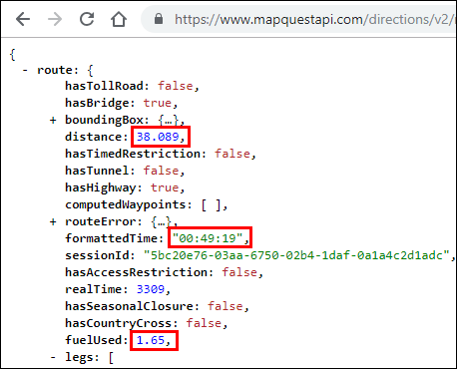
Displaying Trip Data
The final application prints the values for the distance, formattedTime, and fuelUsed keys from the route dictionary.
Starting Location: Washington
Destination: Baltimore
URL: https://www.mapquestapi.com/directions/v2/route?to=Baltimore&key=Your_api_key&from=Washington
API Status: 0
Directions from Washington to Baltimore
Trip Duration: 00:49:19
Miles: 38.089
Fuel Used (Gal): 1.65
=============================================
Starting Location: q
>>>
Notes:
Copy your URL into your web browser. If you collapse all of the JSON data, you will see that there are two root dictionaries: route and info.
Expand the route dictionary and investigate the rich data. There are values to indicate whether the route has toll roads, bridges, tunnels, highways, closures, or crosses into other countries. You should also see values for distance, the total time the trip will take, and fuel usage, as highlighted below. To parse and display this, you will specify the route dictionary and select key/value pair you want to print.

Slide 89
Parse and Display Trip Data
Save your script as 08_json-parse5.py.
Below the API status print command, add print statements that display the from and to locations, as well as the formattedTime, distance, and fuelUsed keys.
Add a print statement that will display a double line before the next request for a starting location as shown below.
if json_status == 0:
print("API Status: " + str(json_status) + " = A successful route call.\n")
print("Directions from " + (orig) + " to " + (dest))
print("Trip Duration: " + str(json_data["route"]["formattedTime"]))
print("Miles: " + str(json_data["route"]["distance"]))
print("Fuel(Gal): " + str(json_data["route"]["fuelUsed"]))
print("=============================================")

Slide 90
Activity - Test Trip Data Display
========== RESTART: /home/user/08_parse-json5.py ==========
Starting Location: Washington
Destination: Baltimore
URL: https://www.mapquestapi.com/directions/v2/route?to=Baltimore&key=Your_api_key&from=Washington
API Status: 0 = A successful route call.
Directions from Washington to Baltimore
Trip Duration: 00:49:19
Miles: 38.089
Fuel Used (Gal): 1.65
=============================================
Starting Location: q
>>>
Run your 08_json-parse5.py script and verify it works.
Troubleshoot your code, if necessary.
You should get a similar output to what is shown here.

Slide 91
Convert Imperial to Metric
Convert the distance and fuelUsed values to the metric system.
print("Kilometers: " + str((json_data["route"]["distance"])*1.61))
print("Fuel Used (Ltr): " + str((json_data["route"]["fuelUsed"])*3.78))

Slide 92
Activity - Test Metric Conversion
========== RESTART: /home/user/08_parse-json5.py ==========
Starting Location: Washington
Destination: Baltimore
URL: https://www.mapquestapi.com/directions/v2/route?to=Baltimore&key=Your_api_key&from=Washington
API Status: 0 = A successful route call.
Directions from Washington to Baltimore
Trip Duration: 00:49:19
Kilometers: 61.32329
Fuel Used (Ltr): 6.236999999999999
=============================================
Starting Location: q
>>>
Run your 08_json-parse5.py script and verify it works.
Troubleshoot your code, if necessary.
You should get a similar output to what is shown here.

Slide 93
Format to 2 Decimal Places
Use the "{:.2f}".format argument to format the float values to 2 decimal places before converting them to string values, as shown below.
Each statement should be on one line.
print("Kilometers: " + str("{:.2f}".format((json_data["route"]["distance"])*1.61)))
print("Fuel Used (Ltr): " + str("{:.2f}".format((json_data["route"]["fuelUsed"])*3.78)))

Slide 94
Activity - Test Formatting Decimal Places
========== RESTART: /home/user/08_parse-json5.py ==========
Starting Location: Washington
Destination: Baltimore
URL: https://www.mapquestapi.com/directions/v2/route?key=your_api_key&to=Baltimore&from=Washington
API Status: 0 = A successful route call.
Directions from Washington to Baltimore
Trip Duration: 00:49:19
Kilometers: 61.32
Fuel Used (Ltr): 6.24
=============================================
Starting Location: q
>>>
Run your 08_json-parse5.py script and verify it works.
Troubleshoot your code, if necessary.
You should get a similar output to what is shown here.

Slide 95
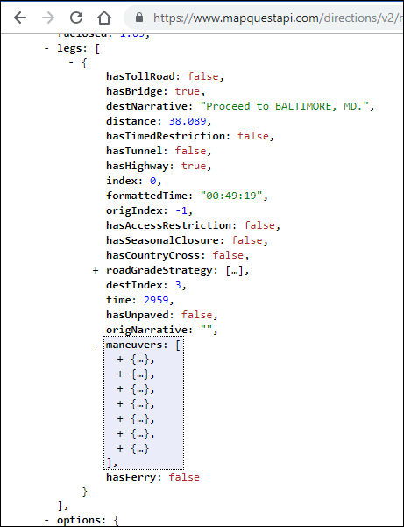
Inspect the Directions JSON Data
Locate the legs list inside the route dictionary.
The legs list includes one big dictionary with most of the JSON data.
Find the maneuvers list and collapse each of the seven dictionaries inside.

Slide 96
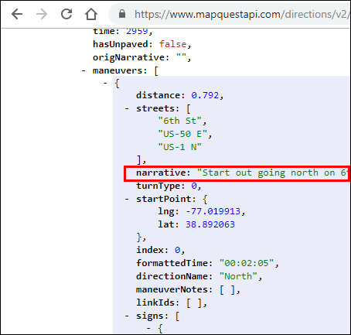
Inspect the Maneuvers JSON Data
Expand the first dictionary in the maneuvers list. Each dictionary contains a narrative key with a value, such as “Start out going north...”
You will parse the JSON data to extract the values for narrative and distance keys to display inside your application.

Slide 97
Iterate Through the Directions Data
Save your script as 08_json-parse6.py.
Add an if statement below the double line print statement to check the json_status.
The for loop iterates through each maneuvers list, prints the narrative, and prints the distance in kilometers formatting for 2 decimal places.
Add a print statement that will display a double line at the end of the list of maneuvers.
print("=============================================")
for each in json_data["route"]["legs"][0]["maneuvers"]:
print((each["narrative"]) + " (" + str("{:.2f}".format((each["distance"])*1.61) + " km)"))
print("=============================================\n")
Notes:
The for loop iterates through each maneuvers list and does the following:
1) Prints the narrative value.
2) Converts miles to kilometers with *1.61.
3) Formats the kilometer value to print only two decimal places with the "{:.2f}".format function.
Note: The print statement must be on one line.

Slide 98
Activity - Test Iteration
========= RESTART: /home/user/08_parse-json6.py ==========
Starting Location: Washington
Destination: Baltimore
URL: https://www.mapquestapi.com/directions/v2/route?key=Your_api_key&to=Baltimore&from=Washington
API Status: 0 = A successful route call.
Directions from Washington to Baltimore
Trip Duration: 00:49:19
Kilometers: 61.32
Fuel Used (Ltr): 6.24
=============================================
Start out going north on 6th St/US-50 E/US-1 N toward Pennsylvania Ave/US-1 Alt N. (1.28 km)
Turn right onto New York Ave/US-50 E. Continue to follow US-50 E (Crossing into Maryland). (7.51 km)
Take the Balt-Wash Parkway exit on the left toward Baltimore. (0.88 km)
Merge onto MD-295 N. (50.38 km)
Turn right onto W Pratt St. (0.86 km)
Turn left onto S Calvert St/MD-2. (0.43 km)
Welcome to BALTIMORE, MD. (0.00 km)
=============================================
Starting Location: q
>>>
Run your 08_json-parse6.py script and verify it works.
Troubleshoot your code, if necessary.
You should get a similar output to what is shown here.

Slide 99
Check for Invalid User Input
Save your script as 08_json-parse7.py.
The final step is to finish the if loop to respond to the user when the json_status does not equal 0.
The most common error will most likely be for invalid location entries.
Create a elif function that checks for json_status = 402 and display a message, as shown here.
if json_status == 0:
.
.
.
elif json_status == 402:
print("**********************************************")
print("For Staus Code: " + str(json_status) + "; Invalid user inputs for one or both locations.")
print("**********************************************\n")
print("=============================================")
Notes:
Now you are ready to add one final feature to your application to report an error when the user enters invalid data. Recall that you started an if loop to make sure the returned statuscode equals 0 before parsing the JSON data.
But what happens if the statuscode is not equal to 0? For example, the user might enter an invalid location or might not enter one or more locations. If so, then the application displays the URL and asks for a new starting location. The user has no idea what happened. Try the following values in your application.
Washington and Beijing
Washington and Balt
Washington and <no entry>
What results do you get?
The if loop does not yet have a contingency for when the statuscode is not equal to 0. So the while loop starts over and the user is presented with the Starting Location input query.

Slide 100
Check for Other Error Types
Invalid user inputs is only one error type.
You could write code to display error messages for other common errors.
For this application, add an else statement that ends the if loop and covers all other json_status values, as shown here.
elif json_status == 402:
print("**********************************************")
print("For Staus Code: " + str(json_status) + "; Invalid user inputs for one or both locations.")
print("**********************************************\n")
print("=============================================")
else:
print("************************************************************************")
print("For Staus Code: " + str(json_status) + ", Refer to:")
print("https://developer.mapquest.com/documentation/directions-api/status-codes")
print("************************************************************************\n")
Notes:
The elif statement prints if the statuscode value is 402 for an invalid location. The else statement prints for all other statuscode values, such as no entry for one or more locations. The else statement ends the if/else loop and returns the application to the while loop.

Slide 101
Activity - Test Full Application Functionality
Run your 08_json-parse7.py script and verify it works.
Troubleshoot your code, if necessary.
For errors, you should get a similar output as shown on the next slide.

Slide 102
========= RESTART: /home/user/08_parse-json7.py ==========
Starting Location: Washington
Destination: Beijing
URL: https://www.mapquestapi.com/directions/v2/route?key=your_api_key&from=WashingtonTurn+right+onto+%E5%89%8D%E9%97%A8%E8%A5%BF%E5%A4%A7%E8%A1%97%2FQianmen+West+Street.+%281.01+km%29&to=Beijing
****************************************************************
Status Code: 402; Invalid user inputs for one or both locations.
****************************************************************
Starting Location: Washington
Destination: Balt
URL: https://www.mapquestapi.com/directions/v2/route?key=your_api_key&from=Washington&to=Balt
************************************************************************
Status Code: 602; Refer to:
https://developer.mapquest.com/documentation/directions-api/status-codes
************************************************************************
Starting Location: Washington
Destination: [no user input]
URL: https://www.mapquestapi.com/directions/v2/route?key=your_api_key&from=Washington&to=
************************************************************************
Status Code: 611; Refer to:
https://developer.mapquest.com/documentation/directions-api/status-codes
************************************************************************

